Slide 1

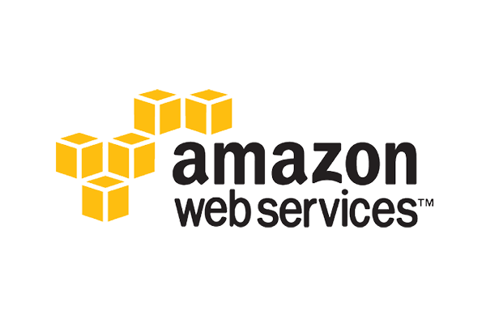
AWS DEMO
cloud computing : Cloud computing is a general term for the delivery of hosted services over the internet.
AWS : Amazon Web Services (AWS) is a secure cloud services platform, offering compute power, database storage, content delivery and other functionality to help businesses scale and grow.
Cloud computing is the on-demand delivery of compute power, database storage, applications, and other IT resources through a cloud services platform via the internet with pay-as-you-go pricing.
AWS-2006 Web services now it is called as cloud.

Slide 2
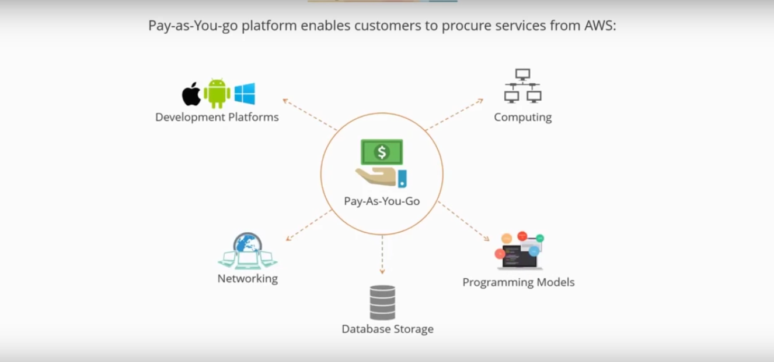
pay-AS-You-Go

Slide 3
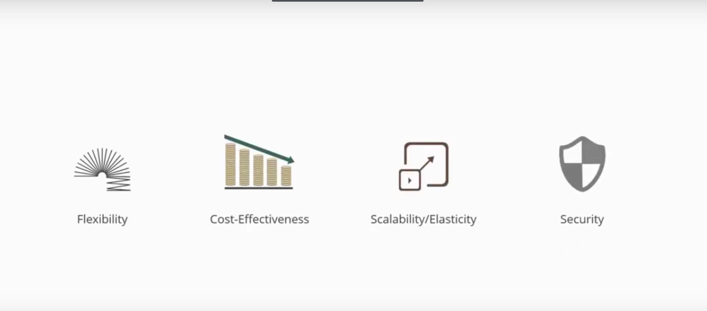
Advatages of AWS

Slide 4
Regions and Availability Zones
Amazon EC2 is hosted in multiple locations world-wide.
Region is a separate geographic area,completely independent.
Each region has multiple, isolated locations known as Availability Zones.
Availability Zones in a Region are connect through low-latency links.
Availability Zones:When you launch an instance, you can select an Availability Zone or let us choose one for you. If you distribute your instances across multiple Availability Zones and one instance fails, you can design your application so that an instance in another Availability Zone can handle requests.
An Availability Zone is represented by a region code:- us-east-1a

Slide 5
Regions and Availability Zones
Code Name
us-east-1 US East (N. Virginia)
us-east-2 US East (Ohio)
us-west-1 US West (N. California)
us-west-2 US West (Oregon)
ca-central-1 Canada (Central)
eu-west-1 EU (Ireland)
eu-central-1 EU (Frankfurt)
eu-west-2 EU (London)
ap-northeast-1 Asia Pacific (Tokyo)
ap-northeast-2 Asia Pacific (Seoul)
ap-southeast-1 Asia Pacific (Singapore)
ap-southeast-2 Asia Pacific (Sydney)
ap-south-1 Asia Pacific (Mumbai)
sa-east-1 South America (São Paulo)

Slide 6
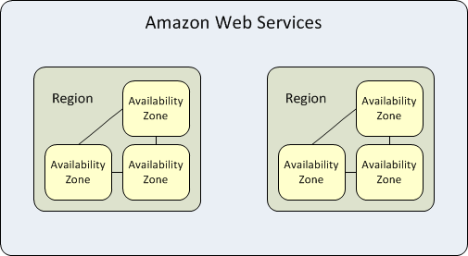
Regions and Availability Zones

Slide 7
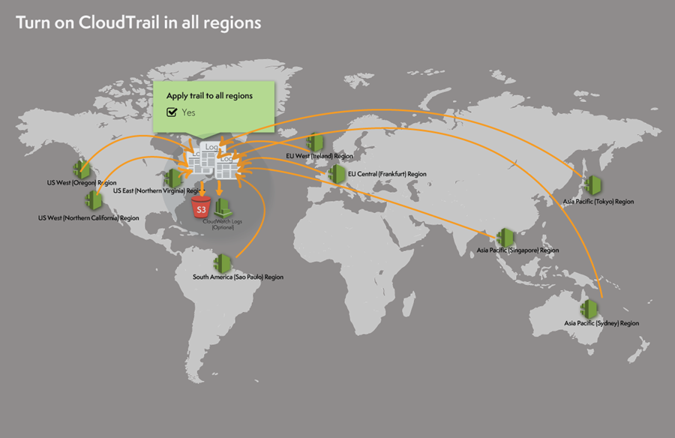
Region

Slide 8
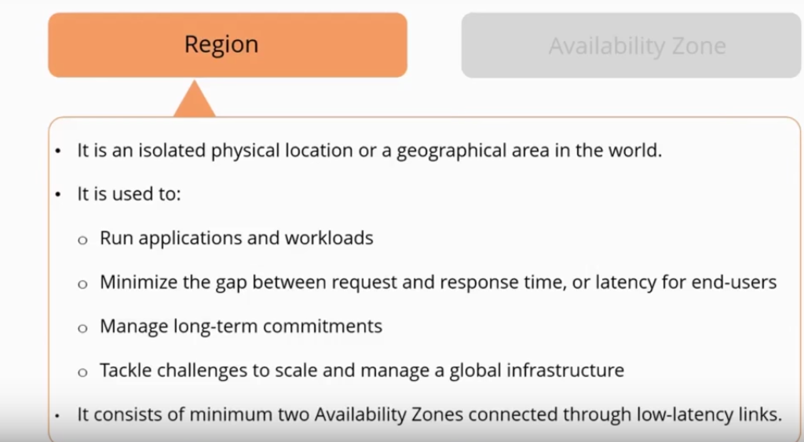
Characteristics of Region and Availability Zone

Slide 9
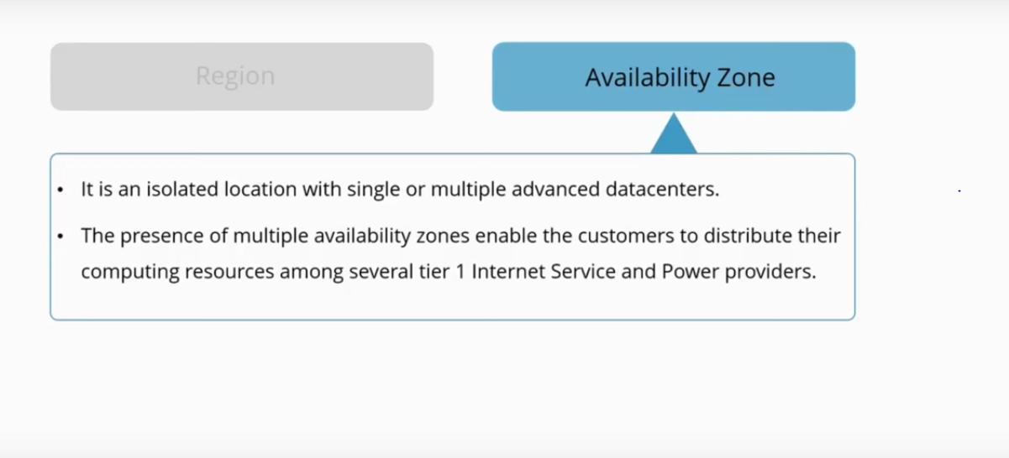
Characteristics of Region and Availability Zone

Slide 10
Accessing AWS:(Ways to Access AWS)
AWS Management Console -- https://aws.amazon.com/console/
AWS CLI
API (Application program interface )-- API Gateway consists of a set of resources and methods,A resource is a logical entity that can be accessed through a resource path using the API,A resource can have one or more operations that are defined by appropriate HTTP verbs such as GET, POST, and DELETE.(webservice,HTTP Req,get,put,delete,update.
SDK's (software development kit ) --Through scripts refering to API it's a specific to your progaram or language.
Application program interface (API) ---> Application program interface (API) is a set of routines, protocols, and tools

Slide 11
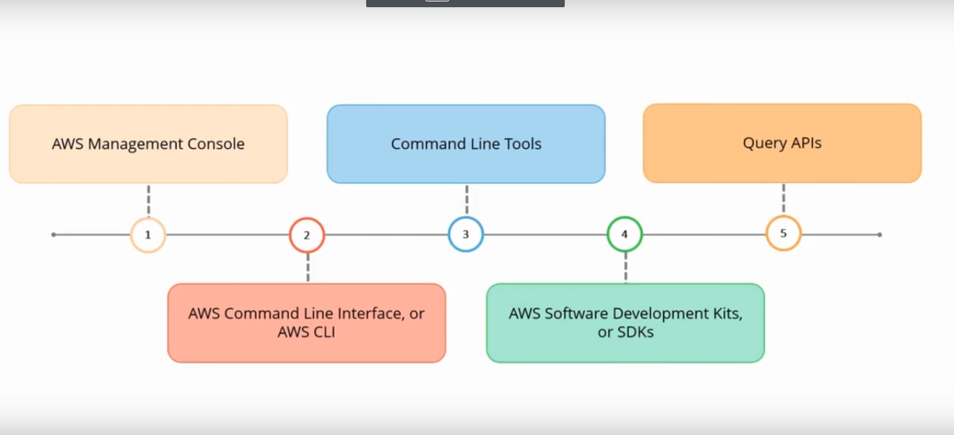
Accessing AWS:(Ways to Access AWS)

Slide 12
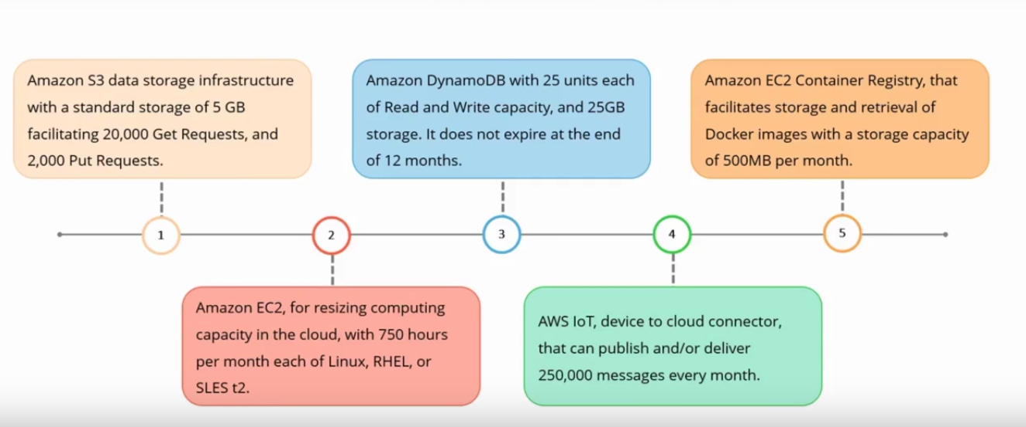
Features of AWS Free Usage Tier
Amazon offers free usage of AWS cloud services for 12 months.

Slide 13
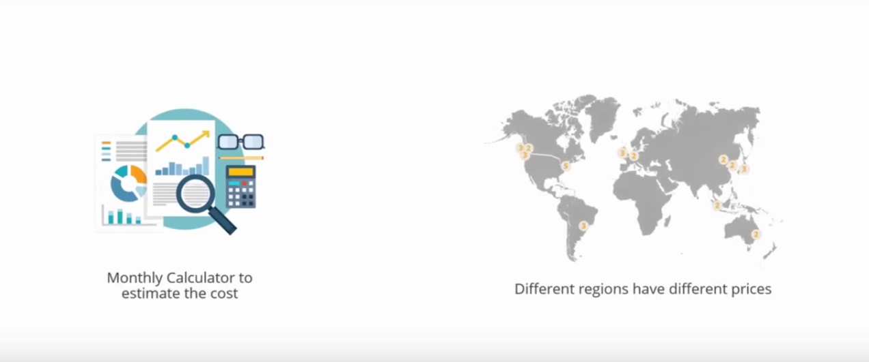
AWS Pricing

Slide 14
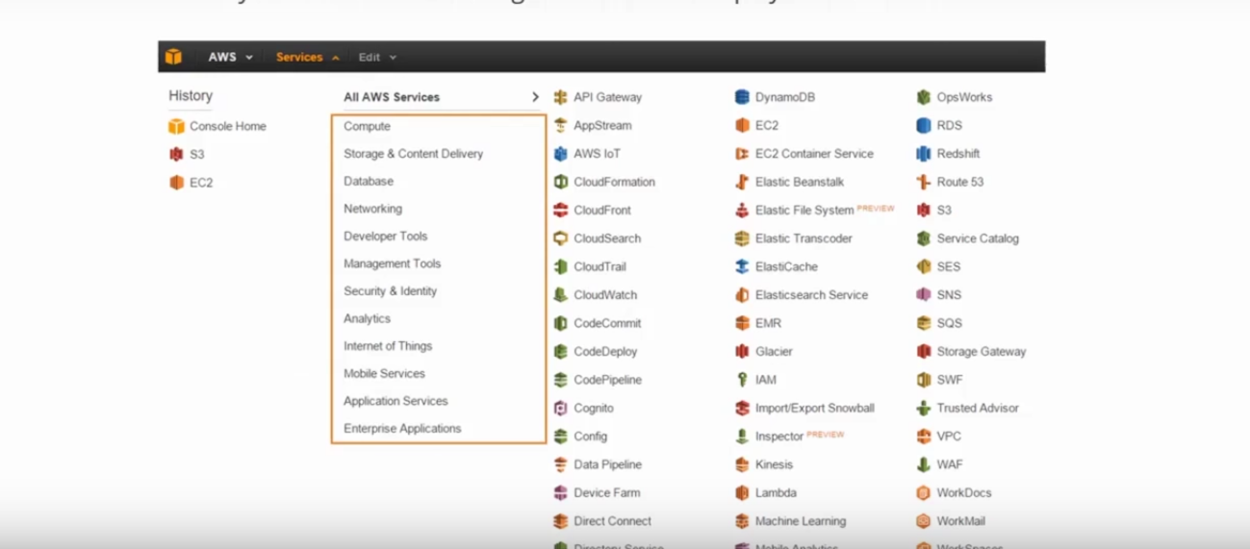
Navigation of AWS Management Consloe
The AWS Management Consloe has a user-friendly web interface,and accessing the consloe requires an AWS account.it Manages all the elements of a user's AWS account that include.

Slide 15
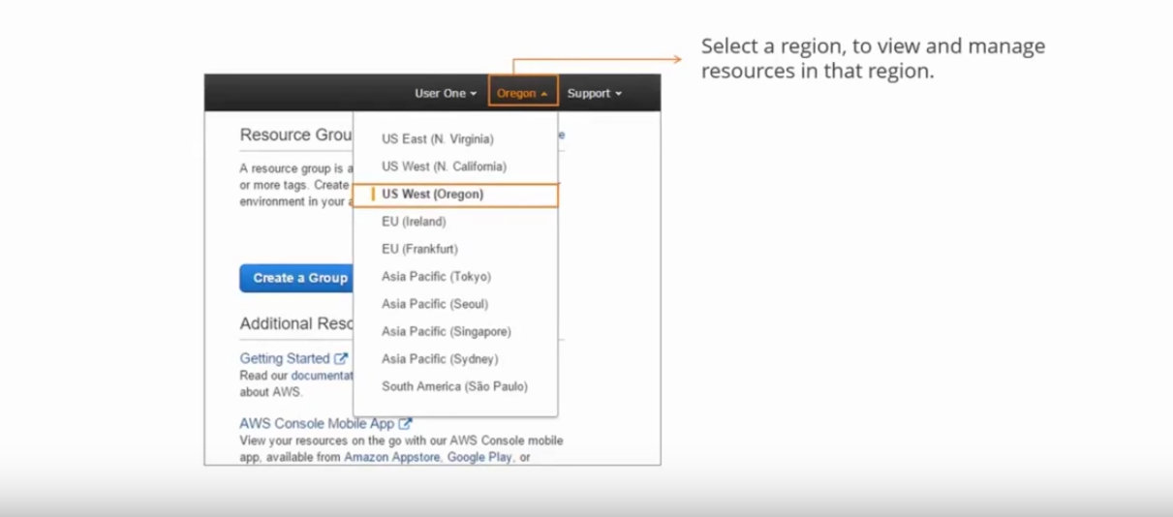
Selecting a Region
Some servives,such as S3 and IAM, are global resoures. and do not require a specific region.

Slide 16
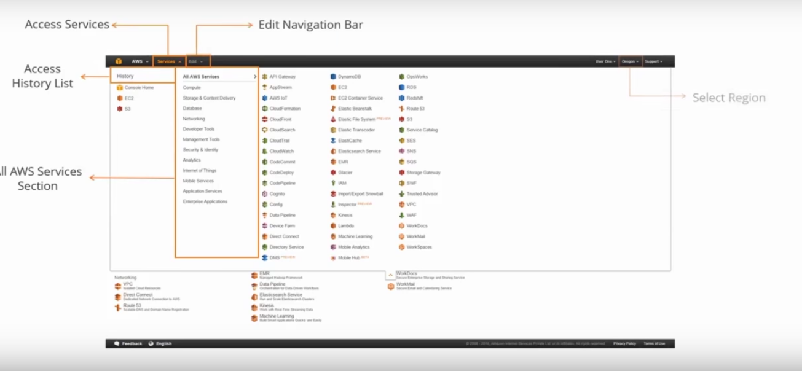
Accessing AWS Services
By default the AWS Management consloe displays all AWS services.

Slide 17
Amazon Web Services
Instance - VM
OS - AMI
N/W - VPC
storage - EBS,S3
H/W - RAM,CPU....
UN/PN - IAM(security)

Slide 18
AWS EC2 Instance Purchasing Options
On-Demand instances — Pay, by the hour, for the instances that you launch.what we use is called.
Reserved Instances(advance payment) — Purchase, at a significant discount, instances that are always available, for a term from one to three years. It's a advance payment,75% discount upto min 1year and max 3 years.
Spot instances — Bid on unused instances, which can run as long as they are available and your bid is above the Spot price, at a significant discount.bidding cheap(it's hr's bases.).
Dedicated hosts — Pay for a physical host that is fully dedicated to running your instances.like BYOL -Bring your own Lic.vm will be dedicated to one host only.
Dedicated instances — Pay, by the hour, for instances that run on single-tenant hardware.
Scheduled Instances — Purchase instances that are always available on the specified recurring schedule, for a one-year term.

Slide 19
AWS certification
AWS Certified Solutions Architect - Associate
AWS Certified Solutions Architect - Professional

Slide 20
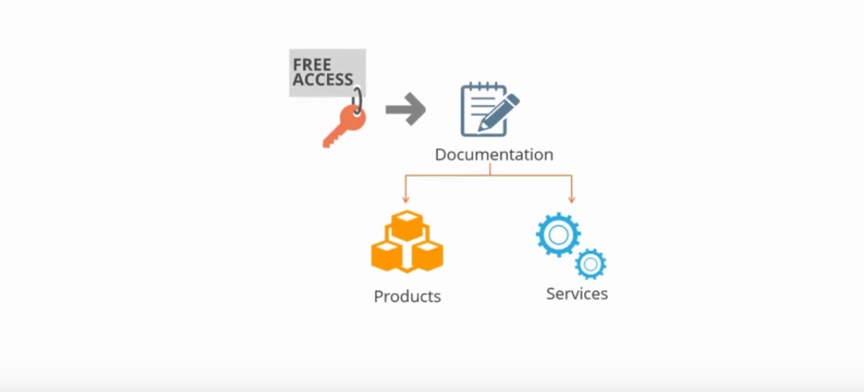
Expert Guidance
Following are the expert guidance provide by Amazon web services.

Slide 21


